Slide 1


Analysis of public sentiment on Twitter versus debate performance of top GOP candidates.
Dealing with Data Final Project- TEAM #2
Team Members: Ankur Chaudhary , Christina Wei, Janul Hernandez, and Peter Meijer

Slide 2

Executive Summary
Project Process
Which sources of data did we look at?
Difficulties in acquiring data.
How did we use the data.
What do the debates say?
A focused look at debate sentiment analysis per candidate through the last 3 debates of the GOP season.
As a GOP candidate has Donald Trump seen more success from negative rhetoric than his running mates?
Public Sentiment?
How is Trump trending on Twitter compared to his running mates?
Conclusion
What does the analysis and data tell us
What could we have done different?

Slide 3
Agenda
Project Process
What Do the Debates Say?
Public Sentiment
Conclusion

Slide 4
Project Process
Data Source
Washington Post
Twitter
Collection
Beautiful Soup
Tweepy
Analysis
Alchemy API
Text Sentiment
Manipulation
mySQL
Visualization
Matplotlib
Tableau

Slide 5
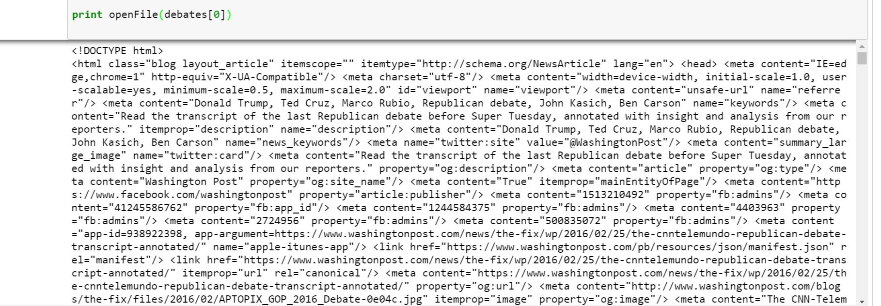
Difficulties
Washington Post
Parsing html
Determining who said what
Removing punctuation
Twitter
Tweepy
429 Overload
Geocode & User Location – user enabled
3200 tweets max per unique query
Topsy
Shut down – 10 days max twitter history
Sentiment Analysis
Throttle error
Notes:
1800 tweets in 15 minutes
200 queries within 1 loop 40 second sleep mode * 16 loops = 3200 tweets max
Sentiment analysis - : only run limited number of sentiments at a time in api

Slide 6
Agenda
Project Process
What Do the Debates Say?
Public Sentiment
Conclusion

Slide 7
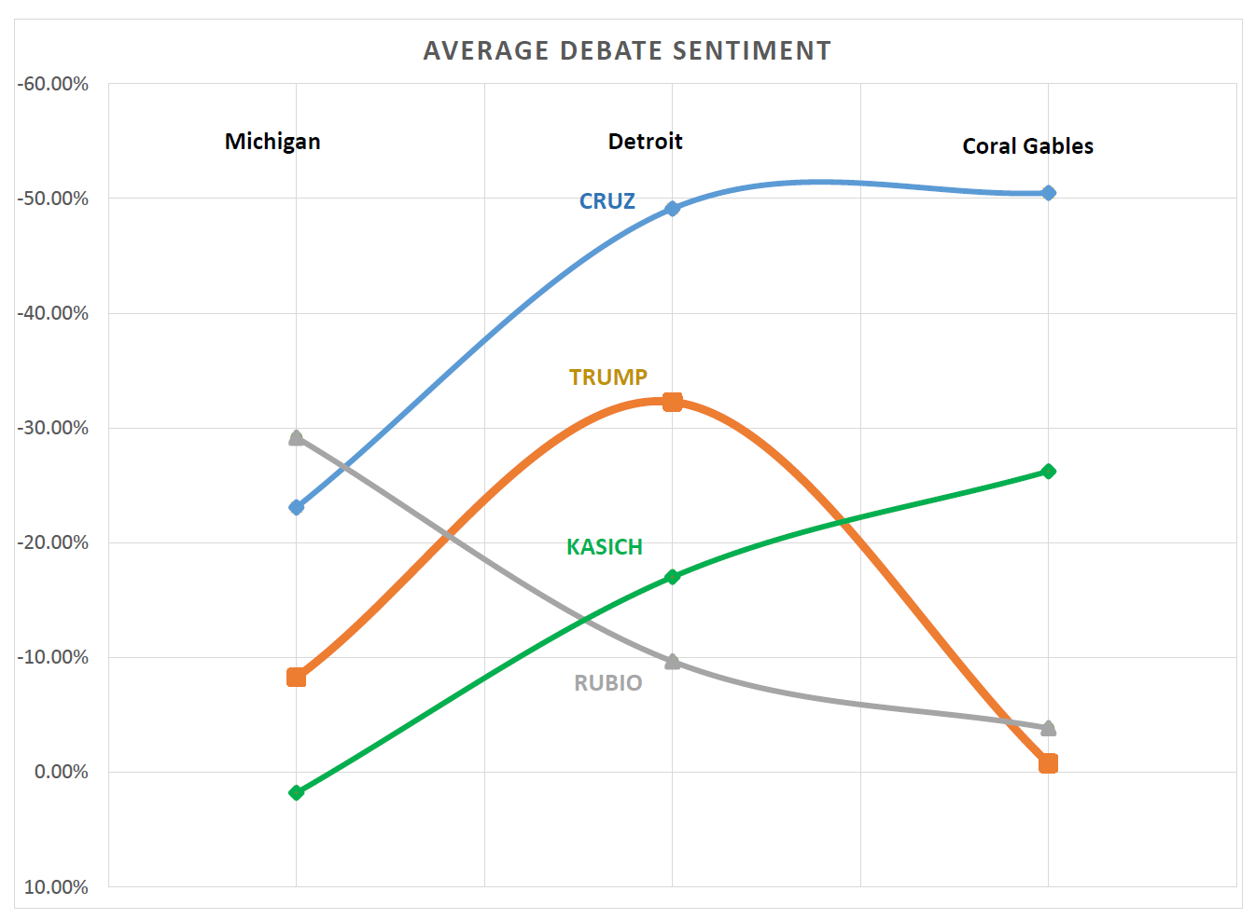
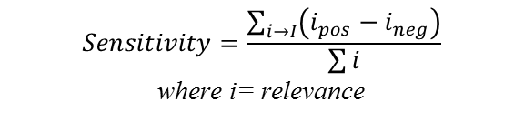
What do the debates say?
$$Sensitivity=\frac{\sum_{i→I}{\left(i_{pos}−i_{neg}\right)}}{\sum{i}}$$
where i= relevance
Cruz and Kasich get more negative as they get desperate.
Trump has an outlier negative performance in Detroit
Rubio continues to be neutral

Slide 8
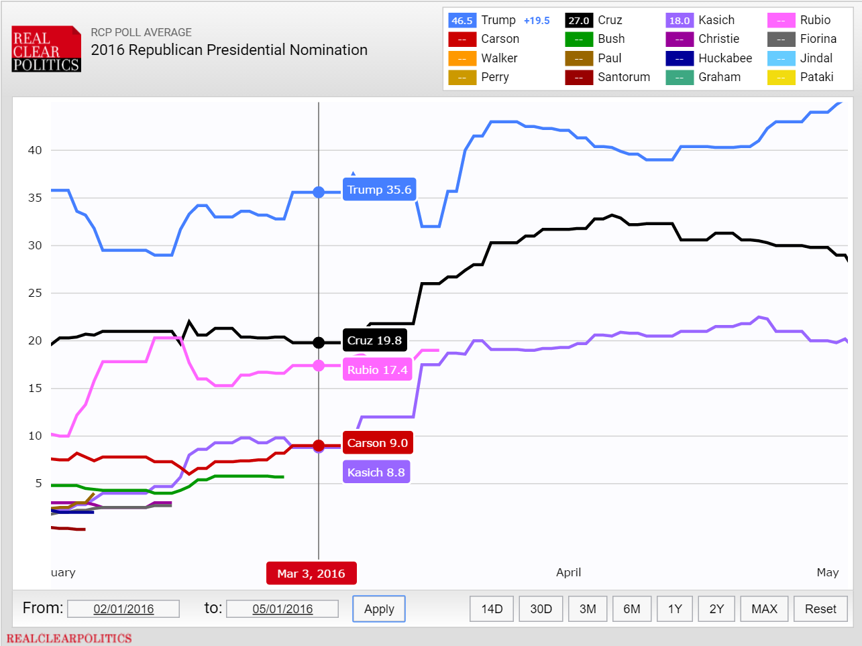



What happened in Detroit?
NEWS HEADLINES
“Trump was attention of attacks at GOP debate”
“Taking On Donald Trump, at Their Own Peril”
“Watch every time FOX News attacked Trump at GOP debate.”

Slide 9
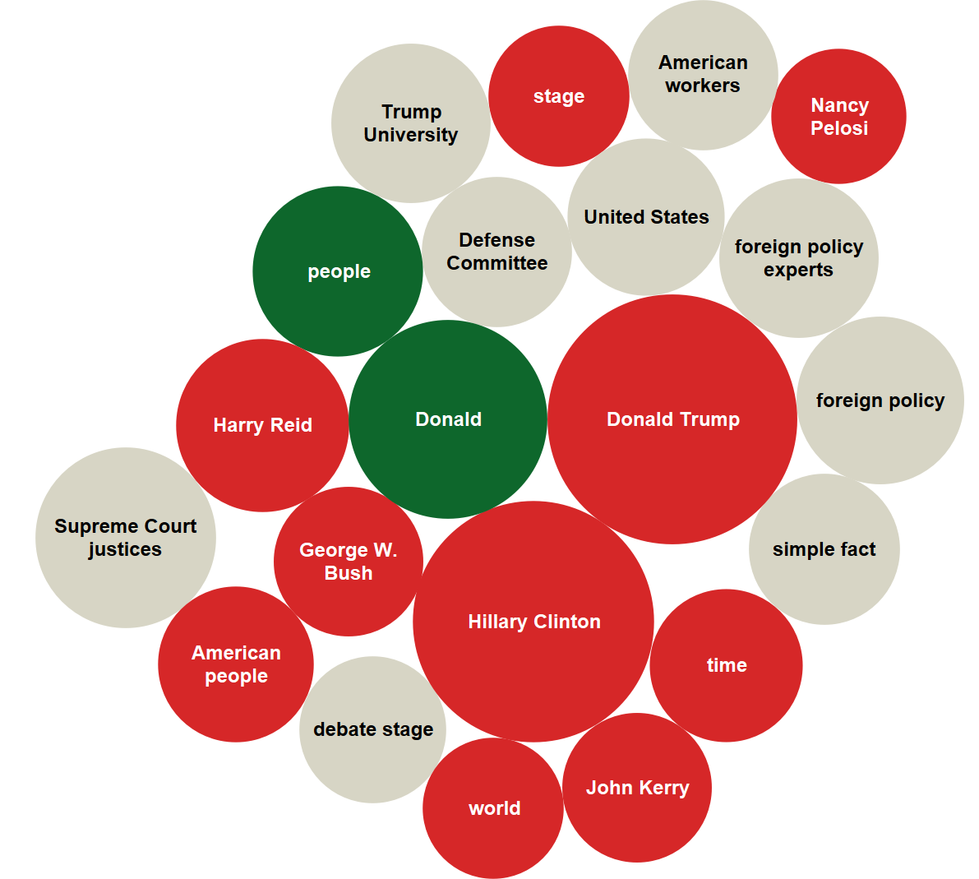
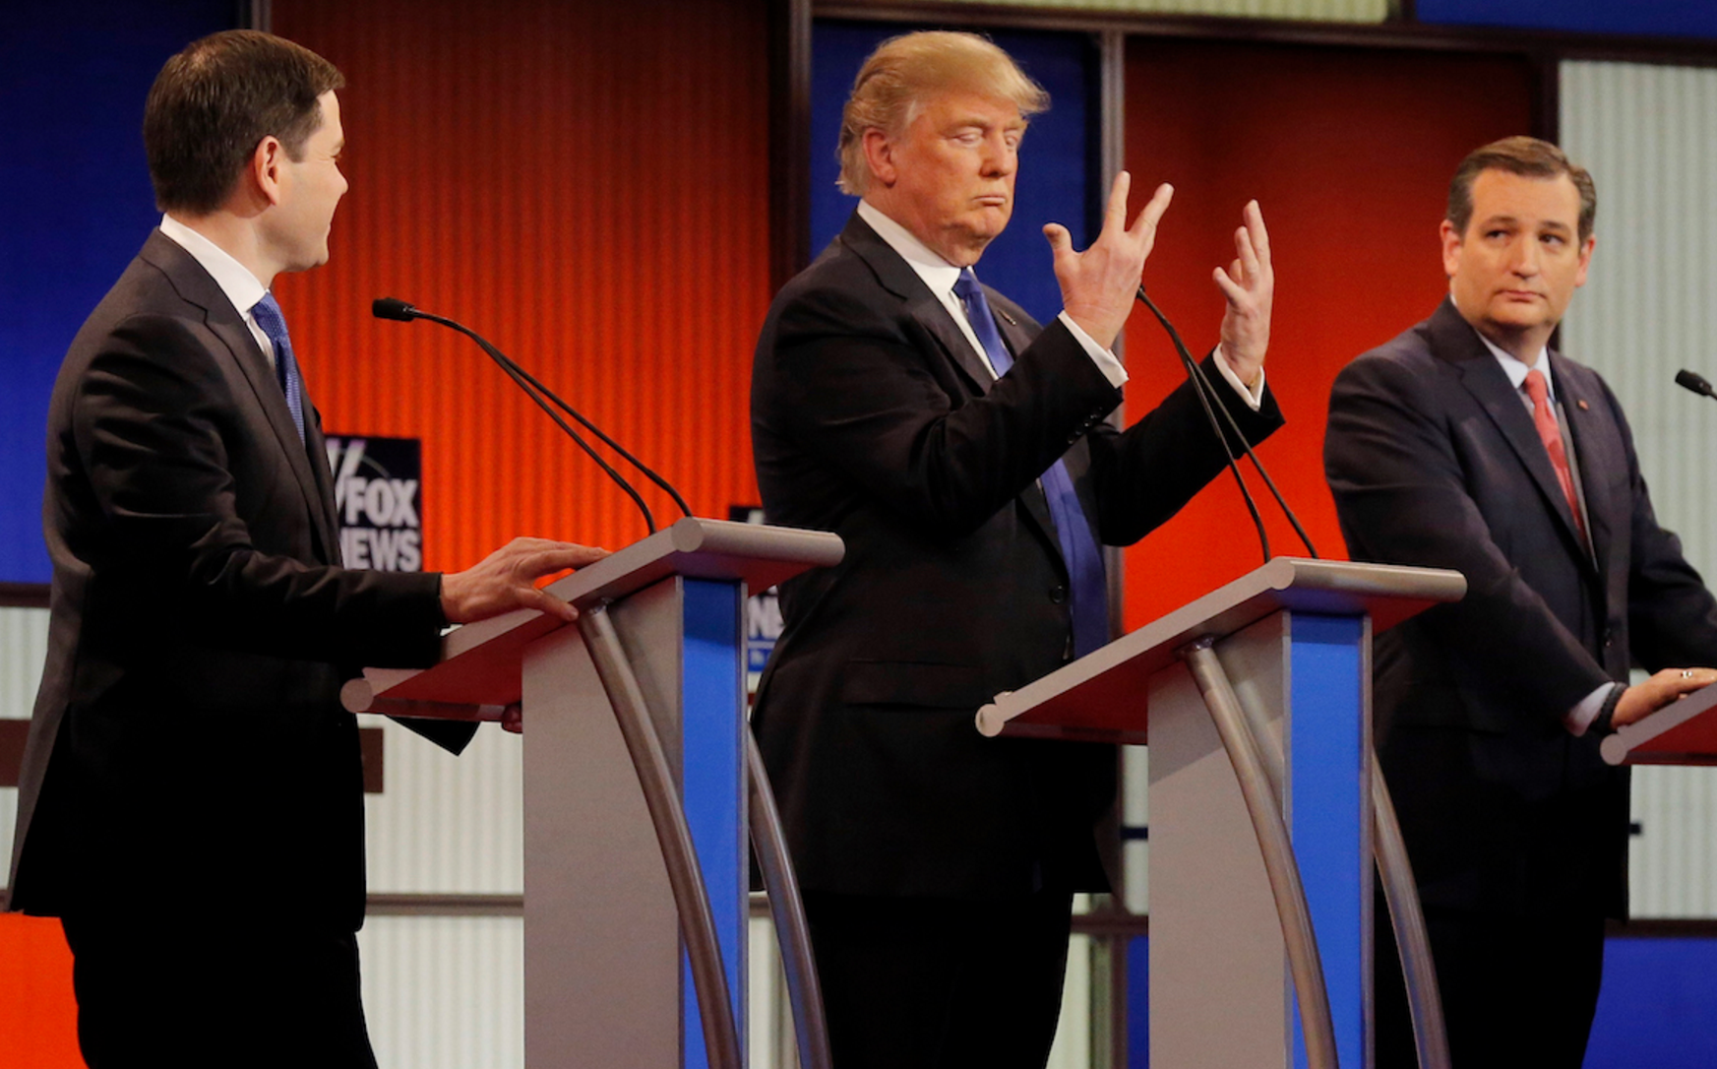
What happened in Detroit?
Trump proving he doesn’t have small hands

Slide 10
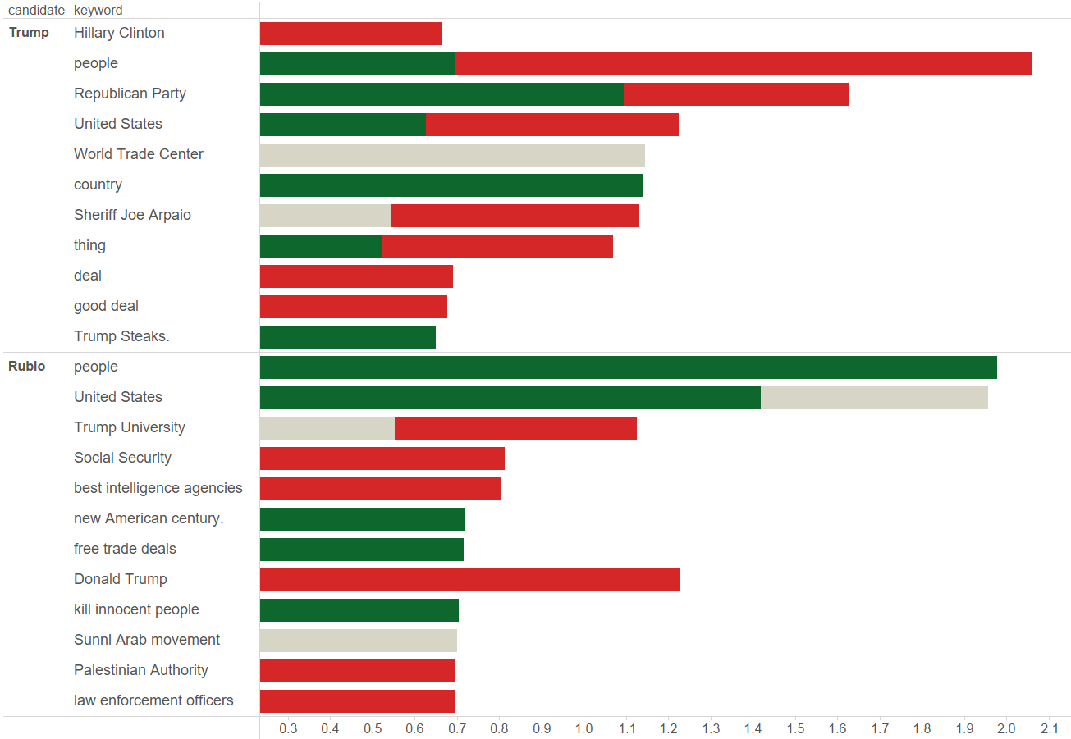
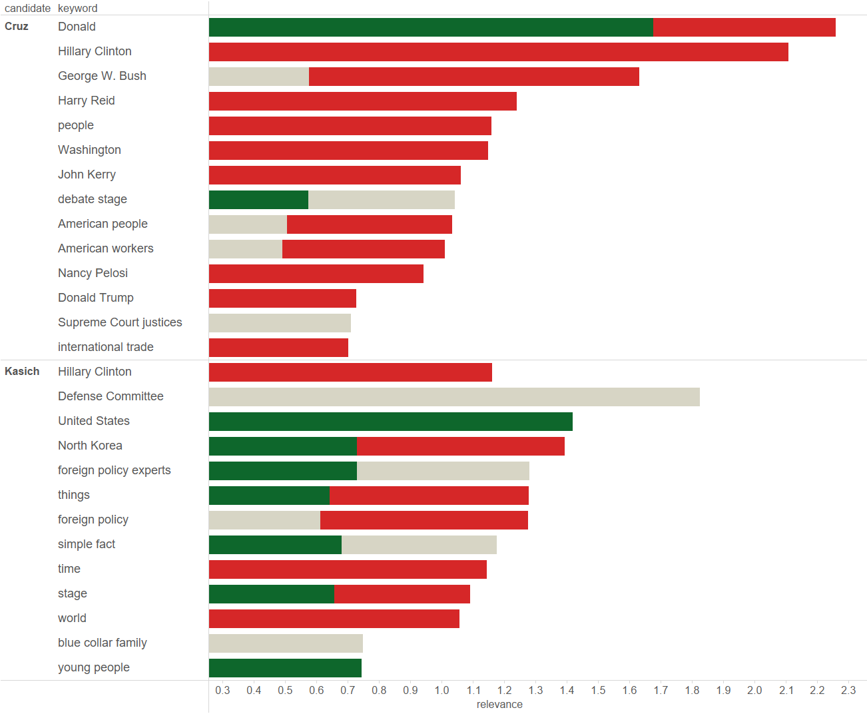
Key Topics Through 3 Debates

Slide 11
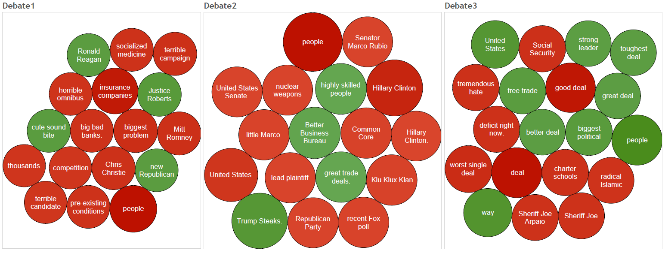
Trump Main Focus
Common theme of the people not being happy.
Denouncing government veterans and current GOP establishment.

Slide 12
Agenda
Project Process
What Do the Debates Say?
Public Sentiment
Conclusion

Slide 13
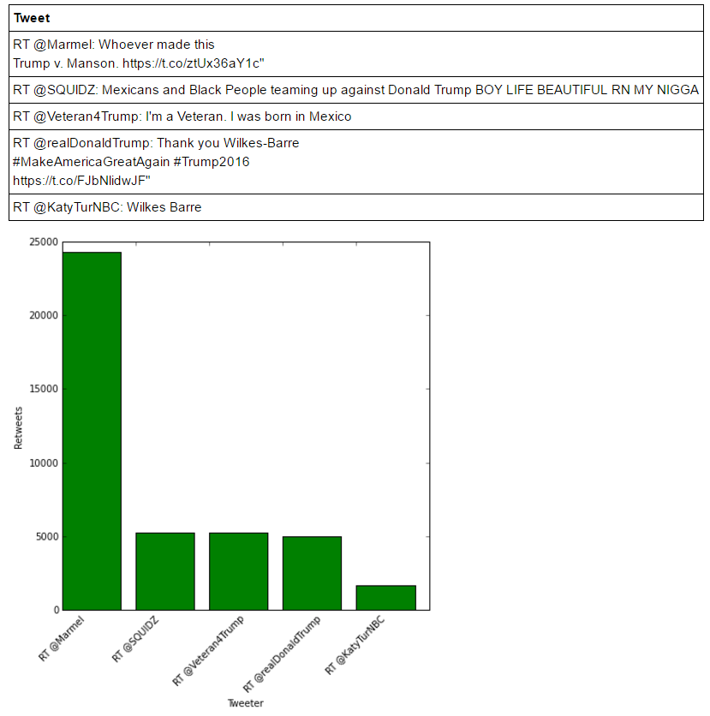
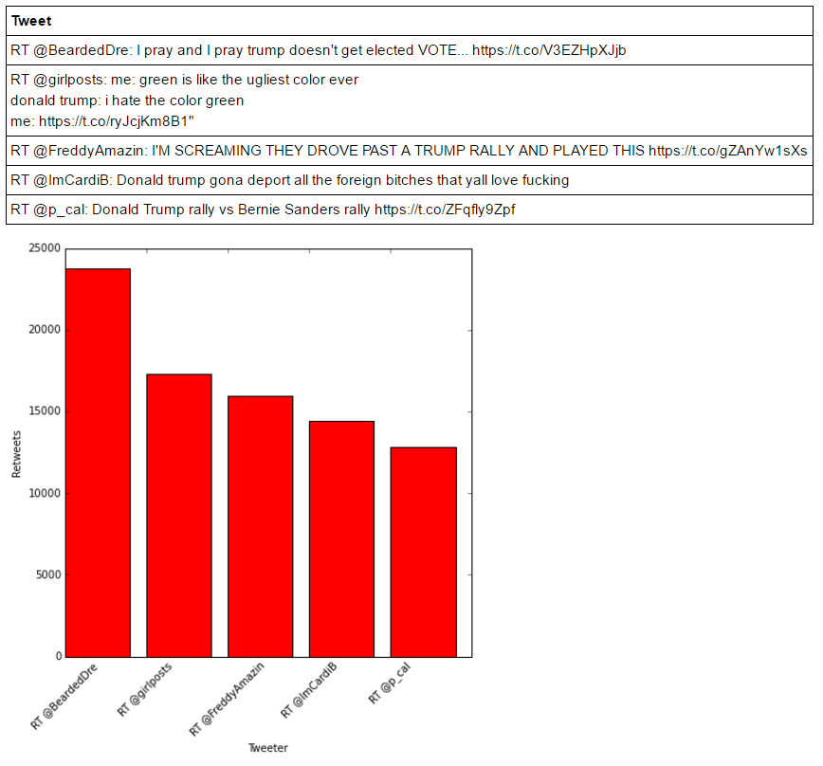
Trump: Top 5 Negative and Positive Tweets

Slide 14
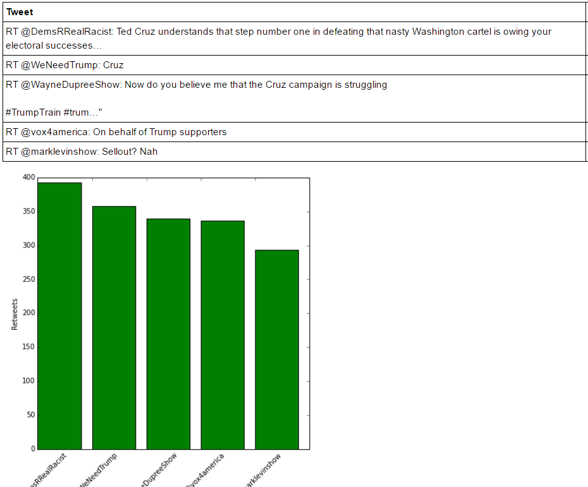
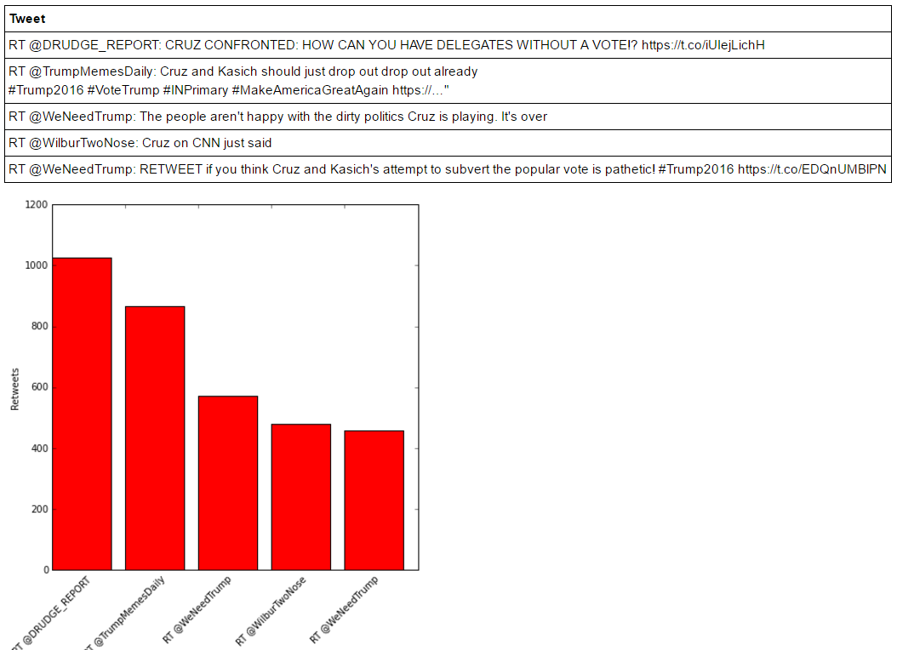
Cruz: Top 5 Negative and Positive Tweets

Slide 15
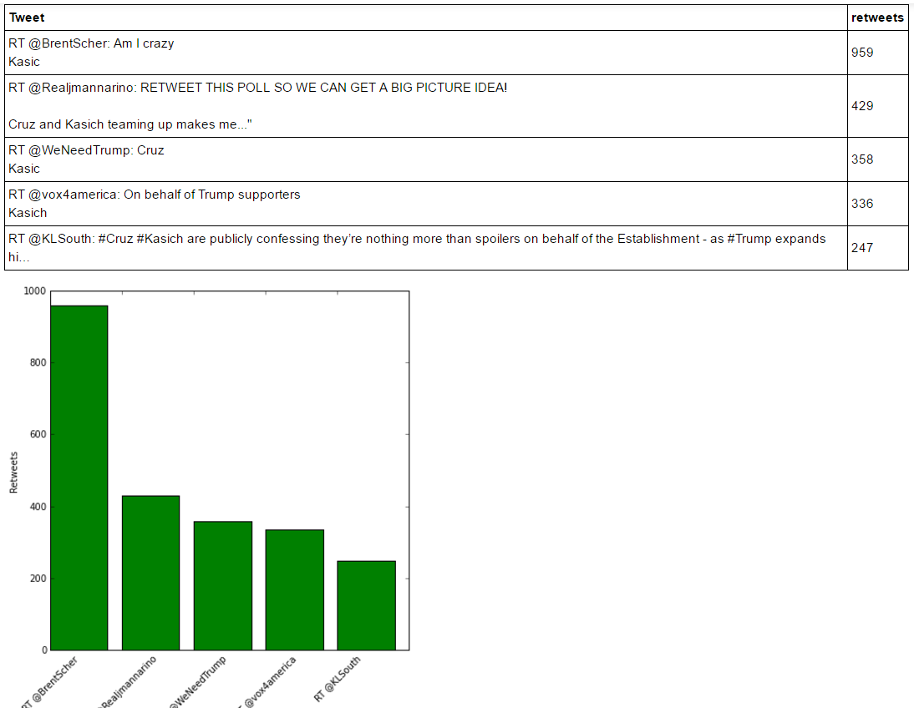
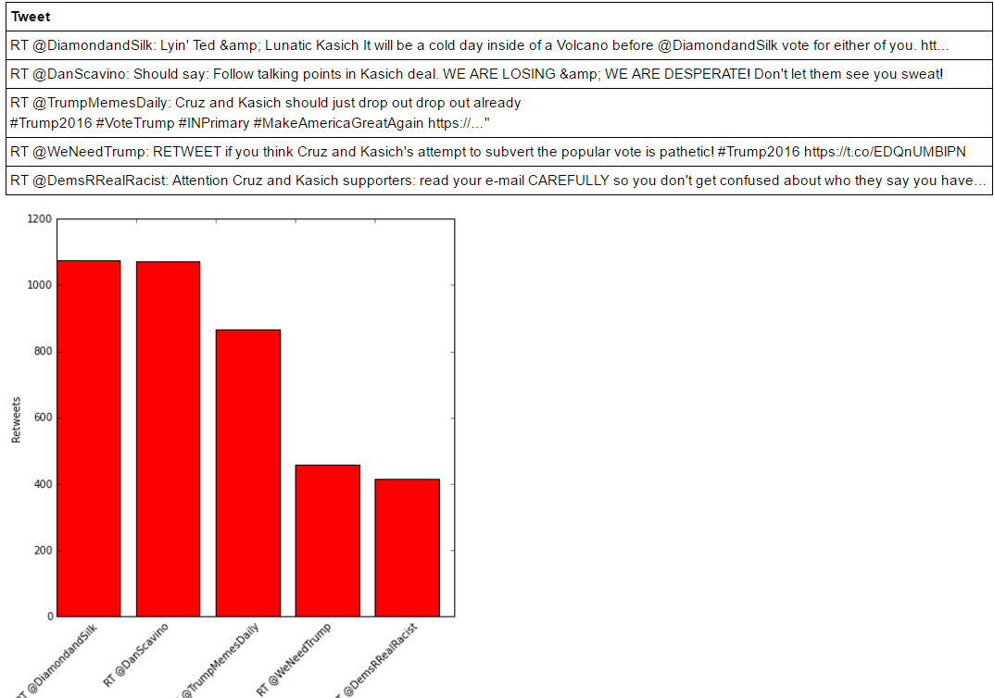
Kasich: Top 5 Negative and Positive Tweets

Slide 16
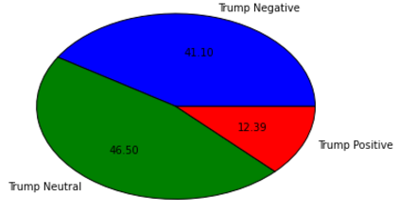
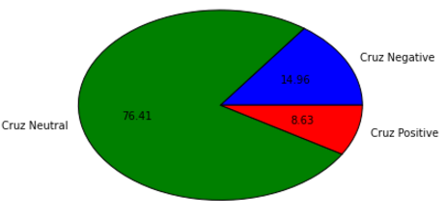
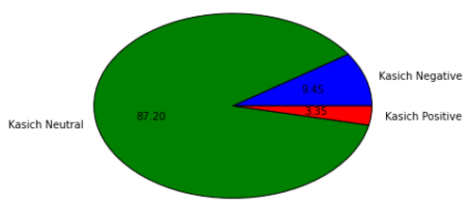
Trump Wins the Popularity Vote
Although all candidates’ tweets have similar sentiment profiles, Trump wins due to the sheer volume of tweets about him

Slide 17
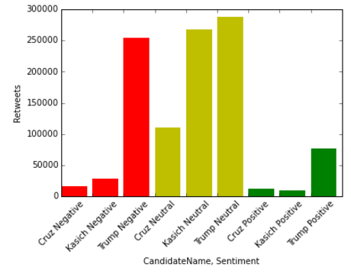
Candidate Sentiment by Volume

Slide 18
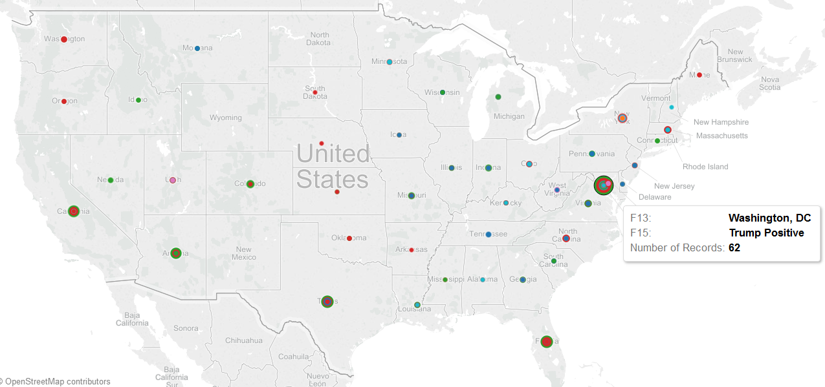
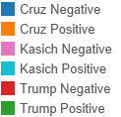
Candidate Tweets by Map

Slide 19
Key Value Drivers
Project Process
What Do the Debates Say?
Public Sentiment
Conclusion

Slide 20
Conclusion
Peter
Write something about how our hypothesis was completely wrong on two aspects. We thought Trump was going to be the overall most negative during debates, he wasn’t. We believed Trump would receive positive support on social media, he didn’t.
Also write something about what we can do to create a more thorough analysis i.e. more debates, more tweets etc.

